Slide 1
1.6.7 Switching between representations

Slide 2
Outline
In this topic, we will
See how to convert between the representations
Rectangular and polar
Learn about the complex exponential

Slide 3
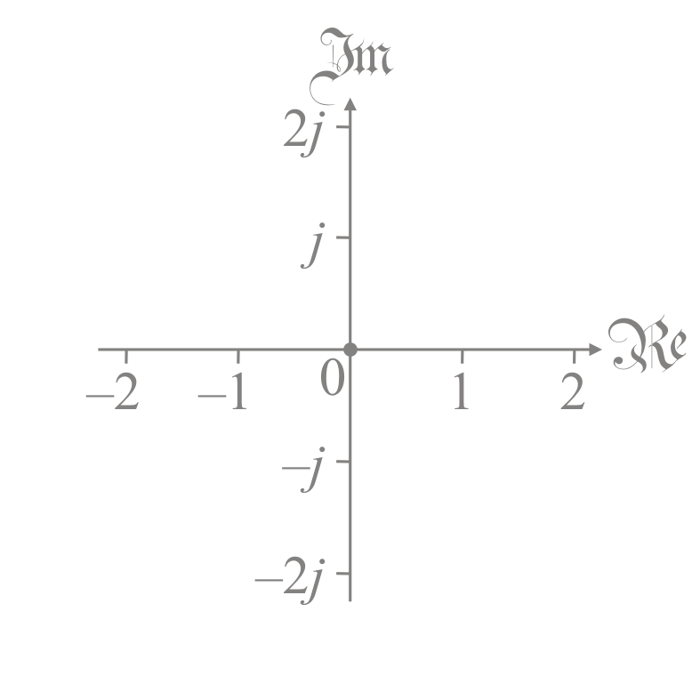
Rectangular to polar
Given the complex number z = α + β j,
this is in the rectangular representation
In order to switch to the polar representation, we must:
Calculate
Calculate arg(z)
We have seen how to do this
You will only be asked to do this where it is obvious:
Multiples of π/4 or 45°
Otherwise, you would use:
numpy.arctan2( beta, alpha )
std::atan( beta, alpha )

Slide 4
Polar to rectangular
Given the polar representation , to calculate the rectangular representation is even easier:

Slide 5
Polar to rectangular
For example, if ,

Slide 6
Polar to rectangular
Now, one observation:
In your calculus course, you will learn that
Therefore,
Therefore, the following two are equivalent:

Slide 7
Summary
In this topic, you now
Know how to convert between the rectangular and polar representations
Have been introduced to the complex exponential

Slide 8
References
[1] https://en.wikipedia.org/wiki/Polar_coordinate_system

Slide 9
Acknowledgments
None so far.

Slide 10
Colophon
These slides were prepared using the Cambria typeface. Mathematical equations use Times New Roman, and source code is presented using Consolas. Mathematical equations are prepared in MathType by Design Science, Inc.
Examples may be formulated and checked using Maple by Maplesoft, Inc.
The photographs of flowers and a monarch butter appearing on the title slide and accenting the top of each other slide were taken at the Royal Botanical Gardens in October of 2017 by Douglas Wilhelm Harder. Please see
https://www.rbg.ca/
for more information.

Slide 11
Disclaimer
These slides are provided for the ne 11 Linear algebra for nanotechnology engineering course taught at the University of Waterloo. The material in it reflects the authors’ best judgment in light of the information available to them at the time of preparation. Any reliance on these course slides by any party for any other purpose are the responsibility of such parties. The authors accept no responsibility for damages, if any, suffered by any party as a result of decisions made or actions based on these course slides for any other purpose than that for which it was intended.

